Slide 1


CAPSTONE PROJECT
PROJECT TITLE
Presented By
Student Name: Karuturi satya srinivas
College Name: Chalapathi institute of technology
Department: electronics and communication engineering
Email ID: satyasrinivaskaruturi@gmail.com

Slide 2
OUTLINE:
Problem Statement (Should not include solution)
Proposed System/Solution
System Development Approach (Technology Used)
Algorithm & Deployment
Result (Output Image)
Conclusion
Future Scope
References

Slide 3
Problem Statement:
Digital payment systems are rapidly increasing in India.
Organizations need tools to analyze digital payment usage trends.
Understanding transaction patterns helps improve financial planning.
Data visualization helps identify transaction growth and patterns.

Slide 4
Proposed Solution:
The proposed system aims to address the challenge of predicting the required bike count at each hour to ensure a stable supply of rental bikes. This involves leveraging data analytics and machine learning techniques to forecast demand patterns accurately. The solution will consist of the following components:
Data Collection:
In this project, the data was collected from a digital payment transaction dataset containing records from 2017 to 2022. The dataset includes information about different digital payment methods such as Debit Card transactions and BHIM transactions.
Data Preprocessing:
preprocessing steps performed: Handling Missing Values, Data Cleaning, Data Formatting, Data Aggregation, Feature Selection.
Machine Learning Algorithm:
Implement a machine learning algorithm, such as a time-series Digital transactions tracking model (e.g., ARIMA, SARIMA, or LSTM), to predict Debit card and BHIM Transactions counts based on historical patterns.
Deployment:
The solution was deployed using Microsoft Power BI, which provides an interactive and user-friendly dashboard.
The dashboard includes Key Performance Indicators, Monthly transaction analysis, Yearly transaction trends, Debit card and BHIM transaction comparisons
Evaluation:
The effectiveness of the system is evaluated based on how clearly the dashboard presents insights from the dataset.
Evaluation criteria include: Accuracy of processed data, Clarity of visualizations, Ability to identify transaction trends, User interaction with dashboard filters and charts
Result:
The developed dashboard provides a comprehensive analysis of digital payment transactions in India.

Slide 5
System Approach:
Dataset contains digital payment transactions from 2017 to 2022.
Visualization tool used: Microsoft Power BI.
Dashboard includes KPI cards, donut charts, line charts and bar charts.
Data is transformed and analyzed before visualization.

Slide 6
Algorithm & Deployment:
Algorithm Selection:
A time-series forecasting algorithm such as ARIMA, SARIMA, or LSTM is used to analyze historical transaction data and identify patterns over time.
Data Input:
The model uses historical data including year, month, digital transactions, debit card transactions, and BHIM transactions.
Training Process:
The historical dataset is divided into training and testing data. The algorithm learns patterns such as trends and seasonal variations from past transactions.
Prediction Process:
After training, the model predicts future transaction trends based on learned patterns from historical data.

Slide 7
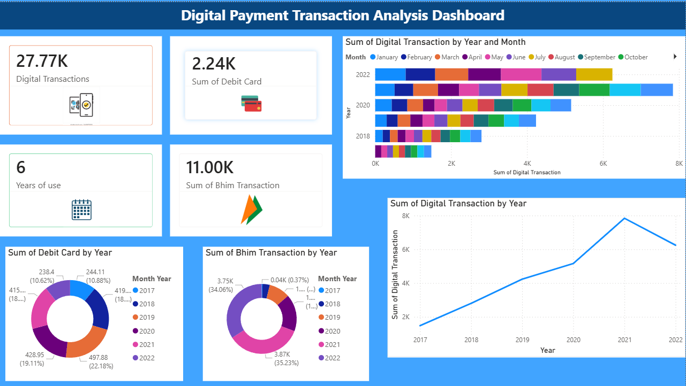
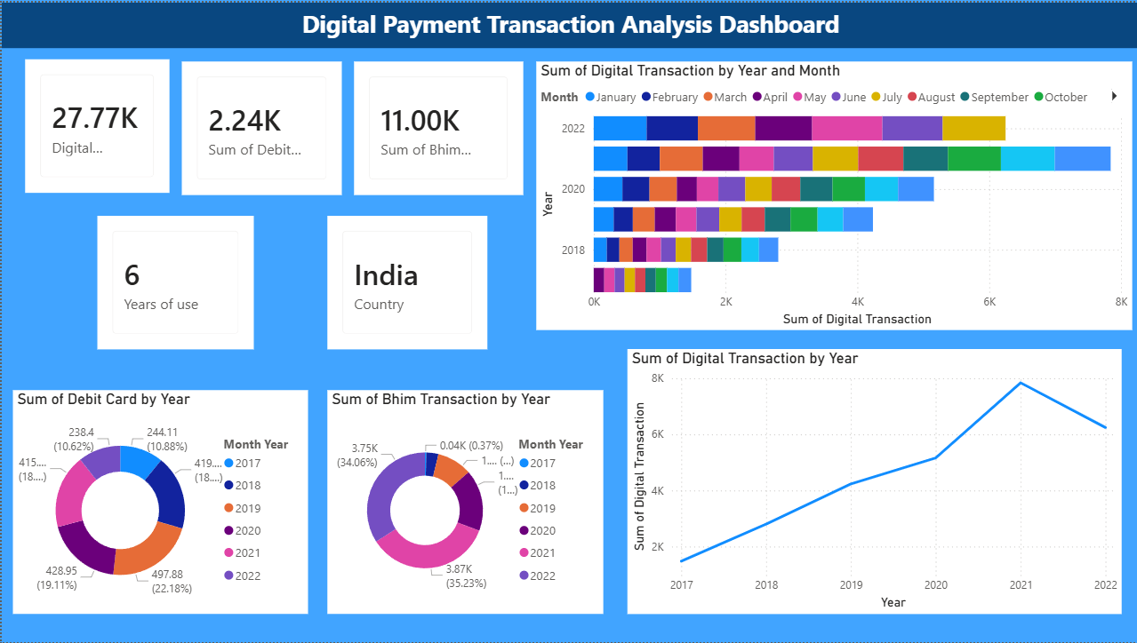
Result:

Slide 8
Conclusion:
Digital payments have increased significantly in India.
Power BI helps transform raw data into meaningful insights.
Data analytics supports better financial decision making.

Slide 9
Future scope:
Integrate real-time payment data sources.
Apply machine learning for transaction forecasting.
Expand analysis to other countries.
Create advanced interactive dashboards.

Slide 10
References:
List and cite relevant sources, research papers, and articles that were instrumental in developing the proposed solution. This could include academic papers on bike demand prediction, machine learning algorithms, and best practices in data preprocessing and model evaluation.
GitHub Link: https://github.com/satyasrinivaskaruturi/MS_Elevate_AICTE-Internship_Karuturi-satya-srinivas.git

Slide 11
Thank You

